Slide 1

Automated Piling Platform
Improving people’s lives.

Slide 2











Why Costain?
Clear purpose, vision and strategy
Future-shaping strategic consultancy
Asset optimisation
Consultancy and advisory
Our purpose is to improve people’s lives
Our vision is to be the UK’s leading smart infrastructure solutions company
Our ‘Leading Edge’ strategy enables us to achieve our purpose and vision
Digital technology solutions
Complex programme delivery

Slide 3

Why Costain?
Our strong culture and embedded values underpin everything we do.
Everyone at Costain is committed to being:
C
O
S
T
A
I
N
Our values
Customer focused
Open and honest
Safe and environmentally aware
Team players
Accountable
Innovative and continuously improving
Natural choice

Slide 4
Why Costain?
Integrated, digitally optimised services
We deliver integrated, digitally optimised smart infrastructure solutions to meet national needs across the UK’s energy, water, transportation and defence markets.
Digitally optimised
Complex programme delivery
Future-shaping strategic consultancy
Consultancy and advisory
Asset optimisation
Digital technology solutions
Leading edge solutions
Improving people’s lives

Slide 5




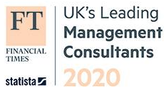
Why Costain?
Our heritage
More than 155 year
Track record
4 hubs
and many projects UK wide including our state-of-the-art technology hub
3,400
Employees across a broad mix of disciplines
£1,162m
Revenue in 2019
Top 50
Employers for
Women 2020
Manchester
London
Top 20
UK Management Consultant
Worle
Maidenhead

Slide 6

























Why Costain?
Who we work with
Infrastructure owners and operators
Local authorities
Central government
Water and energy utilities
Technology developers
Small medium enterprises
Regeneration agencies
Other consultants
Universities and research institutes

Slide 7





Why Costain?
Our digital differentiators
Improving people’s lives for over 155 years
Delivery pedigree and assured deliverability
Long-term strategic relationships and client insight
Still committed to realising the full social, economic and environmental potential on every project
Having led complex programmes in highly regulated, politically charged, stakeholder rich and physically complex environments
Developed by working alongside clients as trusted advisors, understanding the challenges, desired outcomes and co-creating the best solutions
An outstanding network of technology partners
Deep domain, cross sector knowledge
Digital by default
From Microsoft and SAP to niche SMEs, we find the right partners for the challenge
Built up over more than 155 years working as trusted delivery partners across energy, defence, water and transportation
Digitally optimised projects and operations

Slide 8


Why Costain?
Our 2030 responsible business goals
We have listened to our stakeholders and made three commitments, aligned with the UN Sustainable Development Goals, that we believe positions Costain as a leading responsible business.
Create a greener future
Ensure Costain is a safe, inclusive and great place to work, where everyone can be at their best
Enhance the value that Costain contributes to society
Carbon net zero on or before 2035, for all operations
Eliminate waste through an active role in the circular economy
Net positive biodiversity impact and increased natural capital value
Eliminating all harm
Demonstrable improvement in employee wellbeing as a result of being at work
Recognised as the leading inclusive employer in the industry
People rate Costain highly as a great place to work
40% reduction in time on site and 30% reduction in the cost of project delivery contracts
Spend £100m per year with small businesses or voluntary, community and social enterprises (VCSE)
Recognised as a champion for Human Rights
Exceeding all relevant industry regulatory customer satisfaction measures

Slide 9








Why Costain?
Climate change action
Addressing climate change is the biggest challenge of the 21st century and businesses, society and government all have a significant part to play.
We have set an ambition to lead UK infrastructure into a zero carbon future by 2035 at the latest, supporting the Government in meeting their 2050 target.
Our aim is to be a clean growth leader, enabling the uptake of low carbon solutions such as hydrogen and connected & autonomous
mobility, areas we are currently actively working within.
We recognise that the response required to tackle climate change is more complex than carbon reduction alone and we have structured our strategy to reflect this. Notwithstanding this, addressing carbon reduction is fundamental to ensure we help shape UK infrastructure to mitigate and adapt to this global challenge.
Alex Vaughan, CEO
We will achieve our ambition by ensuring
All our operations, including
our supply chain will be net zero carbon by 2035 at the latest against our 2020 baseline
By 2023, every solution
delivered by Costain for our clients will propose low carbon options
Our corporate emissions
from our car fleets will be
net zero carbon by 2030
Our corporate emissions from
our permanent offices will be
net zero carbon by 2022

Slide 10






Why Costain?
Our plan to achieve whole life net zero
Our climate change objectives are clearly linked and contribute to the United Nations Sustainable Development Goals (UN SDGs) both strategically and operationally. We already directly contribute to several of the SDGs through our core purpose of improving people’s lives through smart and sustainable energy, water, defense and transportation infrastructure. Our climate change action plan strengthens and enhances our contribution to several goals, specifically Goal 13 Climate Action.
Our targets and objectives are clearly ambitious and achieving net zero emissions by at the latest 2035 will require considerable effort from our people and many others within our value chain, from clients to our supply chain. We are however confident that with effective support from government, close collaboration and industry knowledge sharing with our value chain, we can achieve these goals.
2020
Further development of our hydrogen based energy solutions to enable the UK hydrogen economy
Establish and implement a group wide PAS2080 framework
2020
Every complex delivery contract to reduce plant idling by 20% from their baseline
Our corporate emissions from our permanent offices will be net zero carbon
2021
2022
Enabling further trials and delivery of technology and infrastructure for connected and autonomous mobility (CAM)
Carbon reduction target & PAS2080 principles required for every contract
2023
All solutions proposed with a low carbon option
Embedding PAS2080 principles throughout the industry value chain: from clients to our supply chain to deliver low and zero carbon infrastructure
2026
2025
2024
Providing innovative, technology-based solutions to deliver smarter, sustainable energy networks for a low carbon future
2027
75% Ultra Low Emission company car fleet
50% reduction in emissions from plant and machinery
2028
2029
2030
2035
Net zero company car fleet
2035
100% net zero plant and machinery fleet

Slide 11

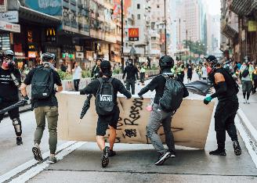



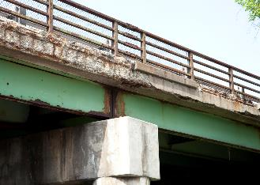

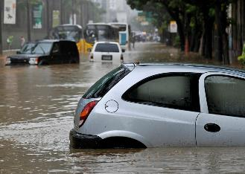

Why Costain?
Responding to a changing world
A more connected, online world
Conflict and protest is increasing
Every company is dependent on technology
AI, robotics and systemic resilience is defining infrastructure networks
Decaying infrastructure assets
A growing and
aging population
Responding to a changing world
Escalating impact from climate change
Macro-strategic risks are now physical, economic and digital

Slide 12
Why Costain?
Our people
What our clients say
Our projects
Our digital services
Improving people’s lives.

Slide 13
What our clients say
Improving people’s lives.

Slide 14
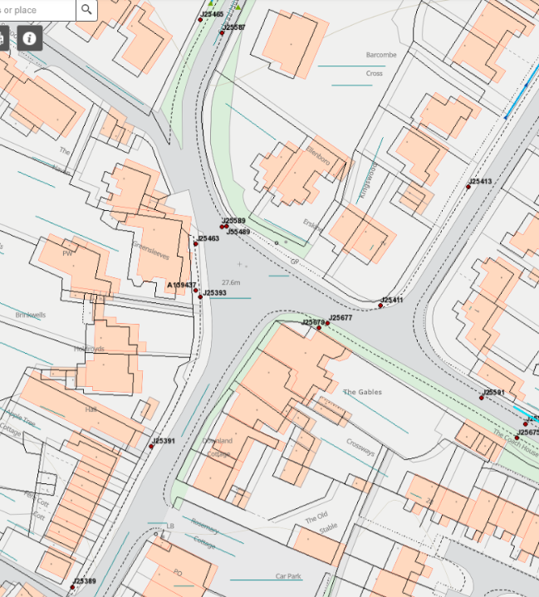

What our clients say
“
Costain’s GIS team are professional, informative and innovative. They provide effective communication and their support helped us better utilise our existing tools to improve the service we provide. Whenever we require assistance we know who to contact and can trust the resolution will be in a timely manner.
“
Lloyd Sattary Javid IT Service Business Analyst, East Sussex Highways

Slide 15
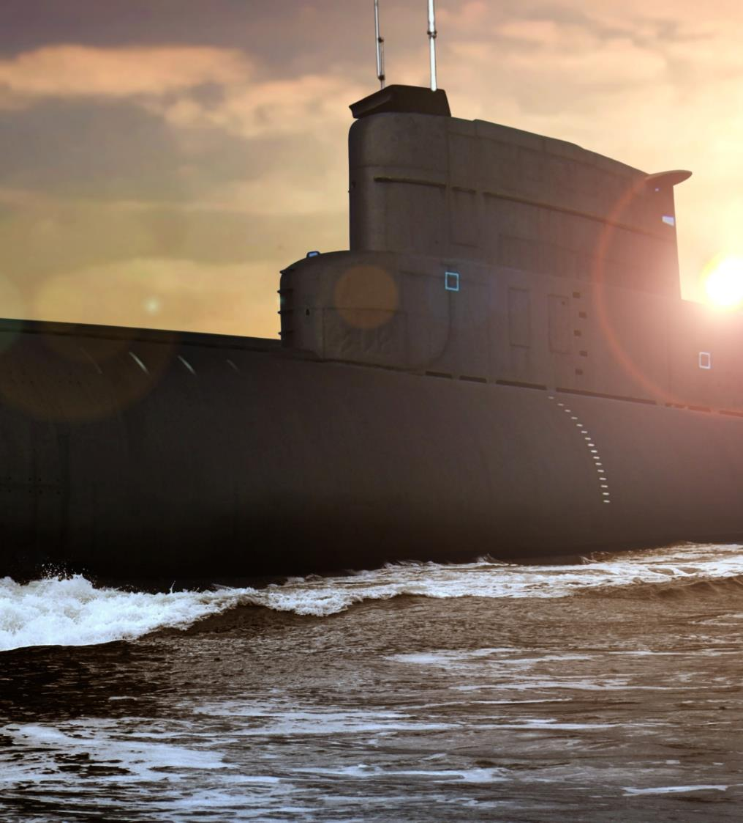

What our clients say
“
SUBMARINES
The Costain team excelled over others in [how well they communicated] as they integrated with the RR team better. I would say that Costain have done this better than everyone else.
“
Aaron Macauliffe Programme Management Director, Rolls Royce Submarines

Slide 16
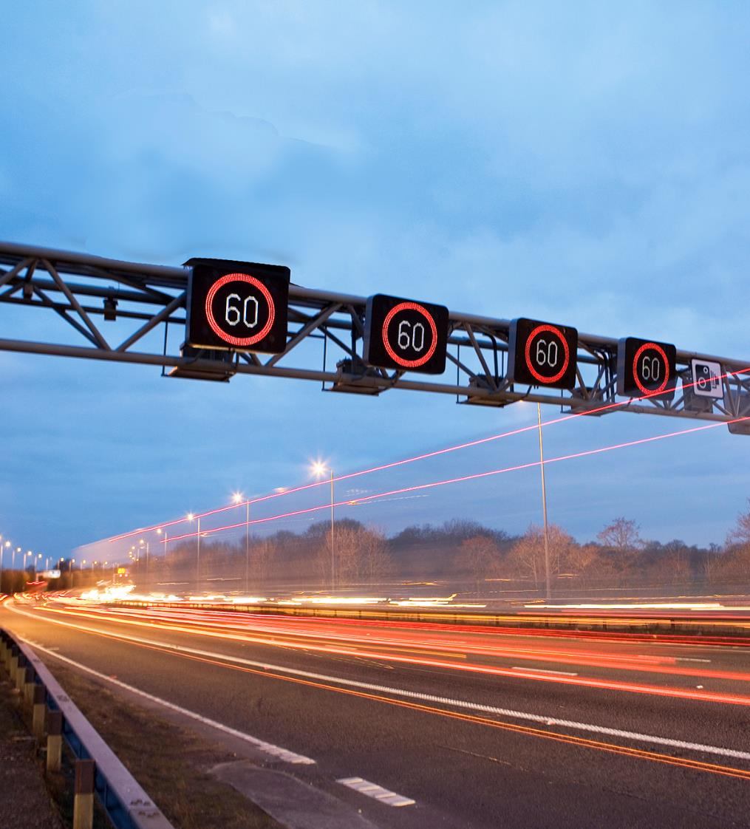

What our clients say
“
It is great to see the project team so strongly aligned to improving customer service and pushing forward, understanding the needs of our customers to deliver a project that actively seeks to minimise the pain for customers. We know it isn’t always easy, but you have shone a light on how to deliver an exemplar scheme.
“
David Bray Smart Motorways Programme Director
Laura Baker Customer Service Director, Major Projects
Mel Clarke Customer Service Director, Operations
Smart Motorways Programme M1 J13-16

Slide 17
Why Costain?
Our people
What our clients say
Our projects
Our digital services
Improving people’s lives.

Slide 18
Our people
Improving people’s lives.

Slide 19





Our people
3,400 employees across a broad range of disciplines
665
Chartered professionals,
deep domain knowledge
Times Top 50
Employers for Women 2020
1,300+
People in consultancy and technology
Five
Diverse employee network groups
c 300
Graduates and apprentices on our award-winning, early career programmes
Over 390
Mental Health First Aiders and signatory to the mental Health at work commitment

Slide 20

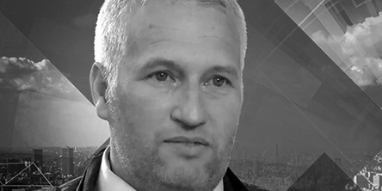



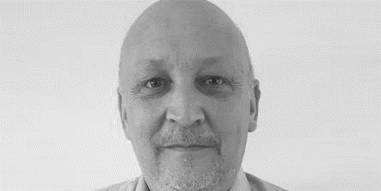


Our people
Meet some of our discipline leads
Michael McNamara
Engineering delivery
Fiona Lacy
Bespoke hardware/software design
Adam Goodall
Augmented and virtual reality
Kum Wah Choy
Connected intelligent infrastructure
Sammy Pandey-Hoyle
3D design and printing
Tim Hall
Data analytics and artificial intelligence
John Batterbee
Clean, connected, automated mobility
Megan O’Connor
Digital sales and growth

Slide 21







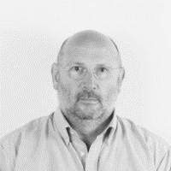
Our people
Meet some of our discipline leads
Paul Eastwood
Systems thinking
Kevin Reeves
Digital twin
Matt Blackwell
Data capture, BIM, GIS mapping & analytics
Darren Silvester
Enterprise architecture
Rob Middleton
Monitoring and situational awareness
Charlotte Webb
Service management
Peter Hill
Signs, signals and sensors
Dan Rennison
Smart delivery platforms

Slide 22
Why Costain?
Our people
What our clients say
Our projects
Our digital services
Improving people’s lives.

Slide 23
Our digital services
Improving people’s lives.

Slide 24

Our services are demand led
Designed and developed with close client consultation
To help clients navigate the digital decade, we have organised our digital capabilities around three service offerings:
Digital advisory
Digital products & services
Digital integration
Advising and assuring on full-life digital solutions for national infrastructure creating sustainable design, deployment and optimisation, delivering savings and efficiencies through our technical and deep domain knowledge – giving you confidence you are setting infrastructure up for success
Specialist hardware and software solutions to maximise operational effectiveness and productivity from infrastructure design, delivery and operation – practical and deployable technology to sustain infrastructure operations
Integration solutions bringing together ours and partner’s digital tools, platforms, data, plans, twins, assets, insights and outcomes – a true smart integrator

Slide 25



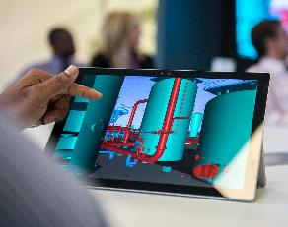

Our digital services
Digital advisory
We work with you to understand your challenges and then advise on a cost-effective solution that helps you meet your goals.
Systems thinking
Design, deliver and reduce the cost of infrastructure development and maximise benefits with our expert systems-based tools and techniques
Data architecture
Maximise the value of organisational data while reducing the costs of managing it
Digital twin
Design, build, operate and optimise assets and an entire asset portfolio using our digital twin expertise
Data capture, BIM, GIS mapping & analytics
Manifest deep understanding of your infrastructure and environment for seamless project delivery
Enterprise architecture
Align your business capabilities, information systems and processes with your strategic goals

Slide 26


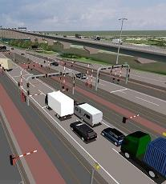

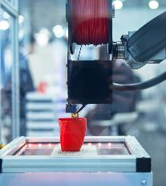

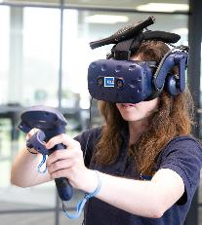
Our digital services
Digital products and services
Monitoring & situational awareness
Increase awareness, improve safety and minimise disruption on your network
Service management – 24/7 help desk
Keep operational control centres running 24/, managing routine and incidents effectively, bringing digital surveillance and data analytics to help prevent issues
Signs, signals & sensors
Keep people safe, informed and moving with advanced and reliable technology
Smart delivery platforms
Boost project performance through a strategic approach to merging and mining project data
3D design & printing
Reduce the time, cost and risk involved in commissioning bespoke components
Bespoke hardware & software design
Secure, robust bespoke solutions delivered at scale
Augmented & virtual reality
Create immersive digital environments to train, induct and test complex scenarios safely and affordably

Slide 27




Our digital services
Digital integration
Connected intelligent infrastructure
Improve awareness, insights, safety, operational performance and reduce environmental impact with our connectivity and sensor services
Solutions architecture
Design and deploy the right over-arching and digitally-enabled infrastructure solutions to work holistically, faster, smarter, safer and more cost-effectively
Data analytics and artificial intelligence
Develop more efficient and resilient infrastructure, with better data, greater foresight and more accurate and predictive insights
Clean, connected, automated mobility
Improve the safety, sustainability and efficiency of transport networks by drawing on our CCAM services which include testing, designing and deploying CCAM enabling infrastructure, EV services, data analytics and visualisation

Slide 28
Why Costain?
Our people
What our clients say
Our projects
Our digital services
Improving people’s lives.

Slide 29
Our projects
Improving people’s lives.

Slide 30

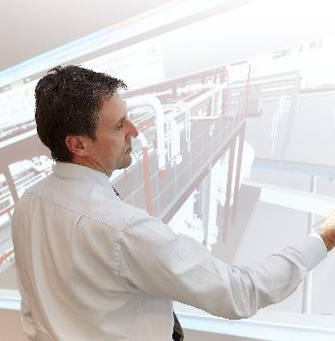

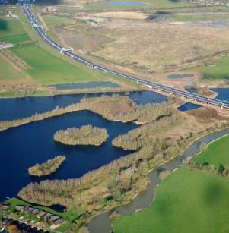
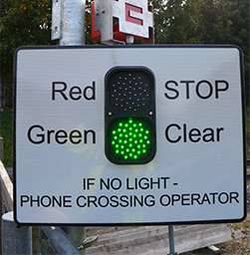

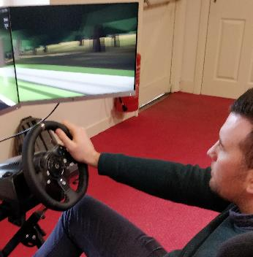

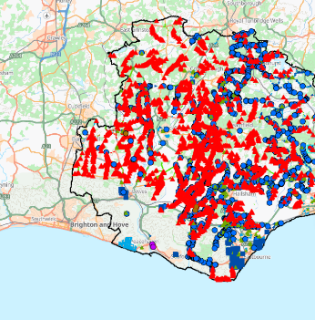
A selection of our projects and products
Shaping a National digital twin
Transforming business performance
Keeping London moving
Optimising programme delivery: A14
Detecting elevated body temperatures
Keeping people safe on railway crossings: Meerkat
Enabling automated vehicle systems interoperability
Optimising customer experience of Jctn 28 on M4
Optimising operational efficiency
Optimising customer experience and road maintenance

Slide 31


Our projects
Shaping a National digital twin
Digital advisory
Key benefits
Faster construction by maximising off-site manufacture and allowing digital rehearsal
Reduced costs by planning to eliminate errors
Enhanced whole life performance by integrating previously siloed systems and processes, unlocking the value of data and information.
Digital twin
Challenge
Enable all organisations in the UK infrastructure value chain to derive value from data through an integrated enterprise model and to ask ‘what if’ in a safe, virtual environment.
Solution
Ongoing collaboration with the Centre for Digital Built Britain, the Infrastructure Client Group, I3P, Tech UK, BSI and other leading organisations, to drive the National Digital Twin evolution in UK infrastructure.

Slide 32
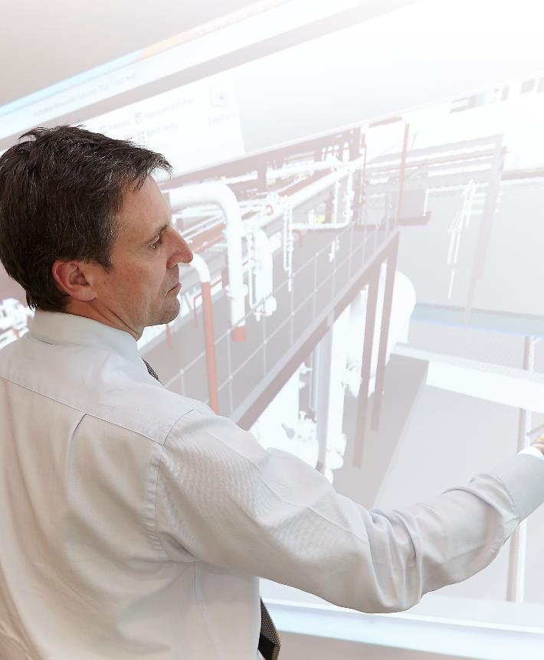
Our projects
Transforming business performance
Digital advisory
Systems thinking
Key benefits
Agile approach to developing the right tool for the processes at every stage​
Defined processes compatible with the client’s culture and ways of working​
Business remained profitable despite fall in oil price from $100 to $40 per barrel by:​
60% reduction in engineering hours consumed​
85% reduction in the number of technical requirements.
Challenge
Improve working methods to offset escalating costs and falling oil prices by counteracting two key factors: an overemphasis on bespoke solutions and a blanket approach to standards conformance.
Solution
Working closely with our global oil and gas company client, we gained understanding of the current systems and applied Costain’s systems thinking expertise to transform dense engineering standards into simple requirement statements and streamline verification processes.

Slide 33

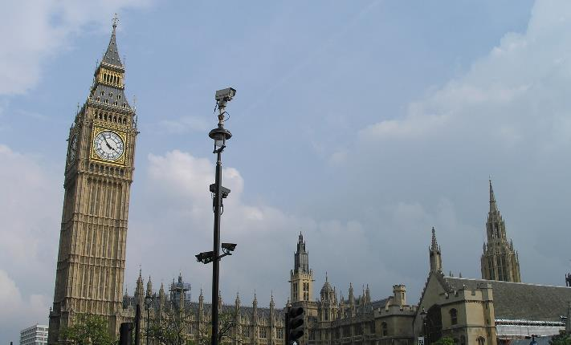
Our projects
Keeping London moving
Digital products & services
Monitoring and situational awareness
Challenge
To reduce congestion and improve London’s poor air quality in support of the Mayor’s ambition for 80% of all journeys to be by public transport, walking or cycling by 2041.
Solution
IRIDES controls over 5,000 Transport for London and stakeholder cameras and gives unprecedented understanding of people’s travelling behaviours and congested zones.
Key benefits
Five months from concept to deployment in time for London 2012 Olympics
Seamless migration from end of life system to IP based digital system
Fast efficient decision making as all key stakeholders can see live video to make decisions collaboratively and act quickly
Cost efficiencies derived from improved functionality and integration with modern systems
Scalable as extra cameras can be added at ease enabling faster and greater coverage.

Slide 34
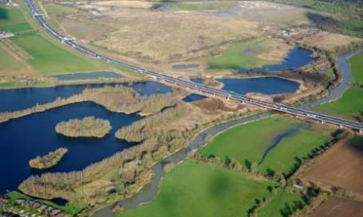
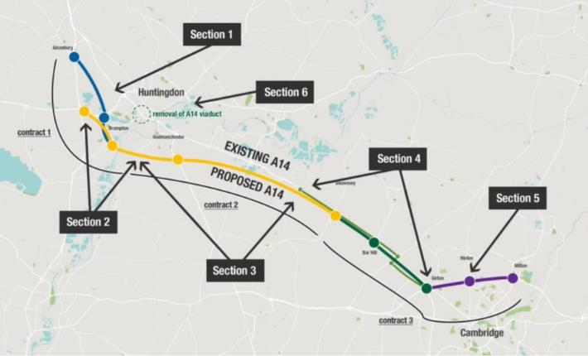

Our projects
Optimising programme delivery: A14
Digital products & services
Key benefits
Delivered 12 months early
Realised £3.5m in efficiency savings from digital initiatives (£109 million saved overall)
Improved forecasting and mitigating the risk of harm
Future-proofed by integrating the next generation of digital road message signs
First project to achieve 44001 collaborative accreditation.
Smart delivery platform (SDP)
Challenge
The need to integrate systems and adopt a common data model to drive project productivity and provide predictive capabilities in health and safety.
Solution
As part of the integrated JV delivery team, Costain’s digital architects, developers and engineering technologists created what Highways England term a ‘digital twin of the production process’ providing historical and real time insights.
Won Digital Initiative of the Year (Civils) and the coveted ‘Overall Initiative of the Year’ at the British Construction Industry Awards 2019

Slide 35
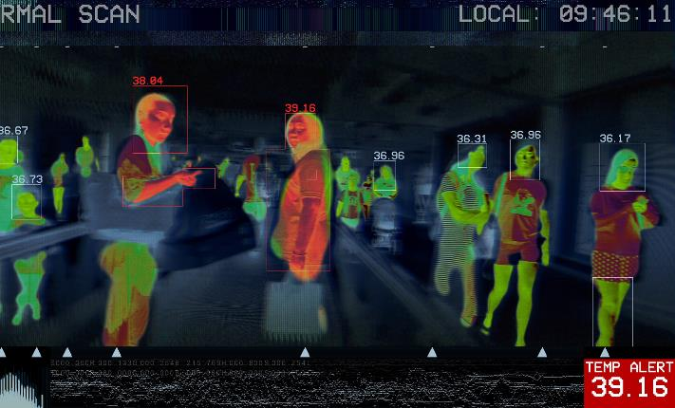
Our projects
Detecting elevated body temperatures
Digital products & services
Key benefits
Instantly detect body temperatures to within +/- 0.3C in an individual or group at distances of around five metres
Rapid design, testing and deployment, installed within two to three weeks
Minimises risk of exposure as operators can maintain a safe distance
Through-life support including 24/7 service desk to support operators
Data management system reduces the analysis work for operators
Ability to switch views at times of reduced risk, ensuring availability for future needs.
Monitoring and situational awareness
Challenge
Monitoring those entering transport hubs and other critical infrastructure sites for an elevated body temperature, helping to reduce the rate of COVID-19 transmission.
Solution
One or multiple thermal cameras and a management system. Our technology consultants with deep domain knowledge of infrastructure environments optimise positioning and seamless integration with existing systems and processes.

Slide 36


Our projects
Keeping people safe on railway crossings: Meerkat
Digital products & services
Signs, signals and sensors
Challenge
To provide an audible and visual warning system to alert and protect pedestrians on railway crossings, especially in more remote areas where a permanent power supply isn’t available.
Solution
We’ve worked with Network Rail to develop a new, wireless and solar-powered alert system that uses radar rather than sensors on the track to detect oncoming trains.
Key benefits
Solar power reduces installation costs, improves energy efficiency and means the devices can be installed anywhere
Innovative use of radar technology eliminates the need for track mounted fixtures
Reduces lineside maintenance time and costs as there are no fixtures to remove
Cloud-based system enables 24/7 monitoring of the technology, even in remote locations
The audible warning is localised to the crossing and is quieter at night preventing noise disruption to surrounding areas.

Slide 37


Our projects
Enabling automated vehicle systems interoperability: A2/M2 Connected Corridor
Digital integration
Clean, connected, automated mobility
Challenge
Creating a network of interoperable, connected corridors for connected vehicles across the Netherlands, Belgium, UK and France to ensure safer and more efficient mobility of people and goods.
Solution
We worked with international partners to develop and deploy the UK’s first European interoperable connected corridor testbed for Cooperative Intelligent Transport Systems (C-ITS) to enable the evaluation of clean, connected and automated mobility (CAM) on UK roads.
Key benefits
Demonstrated viability, scalability and interoperability of the technologies
International industry collaboration involving 62 participants from 34 organisations across six countries
C-ITS technology is the next generation technology to the smart motorway and other infrastructure-intensive services
Enabled emerging CAM technologies to be trialled and tested on UK roads
Helped to position the UK as a leader in CAM technology.
The A2/M2 Connected Corridor Testbed technology project won Project of the Year at the 2019 Intelligent Transport Systems (ITS) awards.
Notes:
The collaborative efforts between Highways England, Department for Transport, Transport for London (TfL) and Kent County Council enabled the design, installation and implementation of one of the UK’s first pilot connected vehicle corridors on a live road.
Costain was responsible for delivering roadside technology using data supplied by Transport for London, Highways England and Kent County Council and a technology testbed for Cooperative Intelligent Transport Systems (C-ITS). This flagship contract will help to promote the UK as a market leader in Connected and Autonomous Vehicle (CAV) and C-ITS technology.

Slide 38
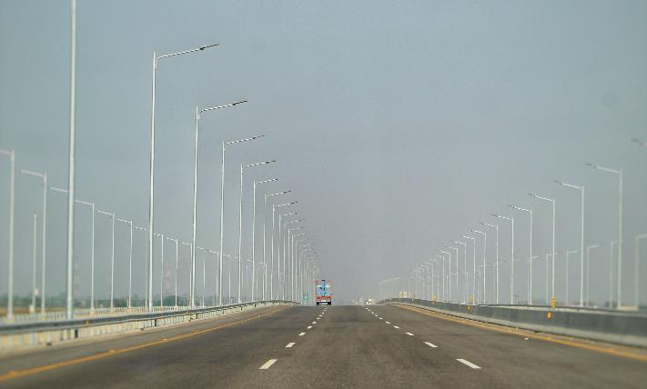
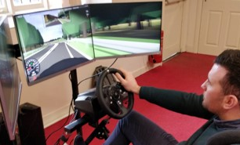
Our projects
Optimising customer experience of Junction 28 on the M4
Digital integration
Solutions architecture
Challenge
The need to deliver safer and improved journey times for the travelling public navigating the M4 junction 28 and two adjacent roundabouts for the Welsh Government.
Solution
Upon completion of the upgrade to Junction 28 of the M4, we undertook traffic flow ANPR and drone surveys to test the performance matched that of what was predicted and subsequently adjusted the traffic model and signal timings.
The project team also supported the development of a virtual reality driving experience, which was trialled with the public.
Key benefits
Increased throughput of the junctions, resulting in less queuing
Safer and improved journey times
Exemplary environmental and climate performance
Highly Commended status for the Sustainability category at the Constructing Excellence Wales Awards 2020.

Slide 39
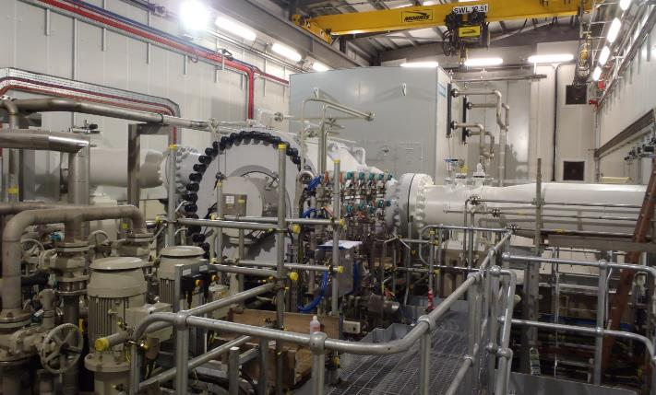

Our projects
Optimising operational efficiency
Digital integration
Data analytics and artificial intelligence
significantly more accurate than existing methods.
Key benefits
Emissions can be predicted regularly with the ANNIE model.​
Prediction with much improved accuracy (94% compared to around 50%), allowing the project to predict NOx produced for a given operational strategy, ensuring compressors could be operated efficiently and within environmental consent limits for NOx.​
Savings of £30 million where an existing unit can continue to be used, rather than upgrading.​
More accurate recording of pollutants produced by gas turbine fleet.
Challenge
The client wanted to understand how levels of NOx produced at compressors are affected by the chosen operating strategy. The output would support choice of optimal operating strategy in future.
Solution
Our in-house AI tool, ANNIE, was used to develop a predictive model to analyse parameters such as turbine and compressor speed, exit temperature and oxygen content in the flue gases. The model makes use of thousands of operating points over the last ten years, making it

Slide 40
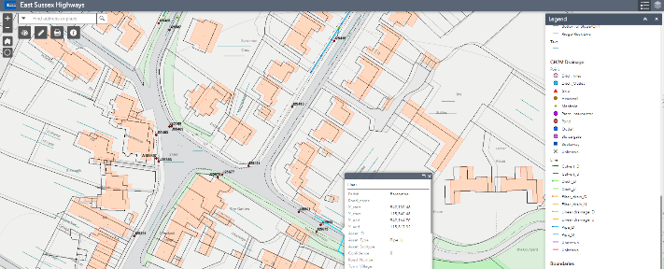
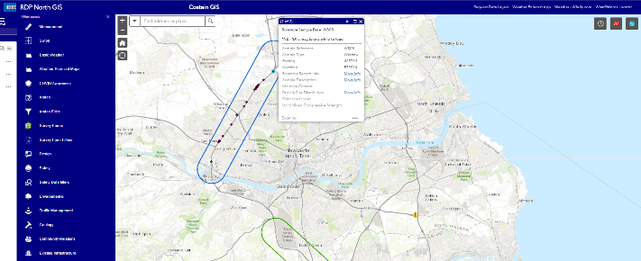
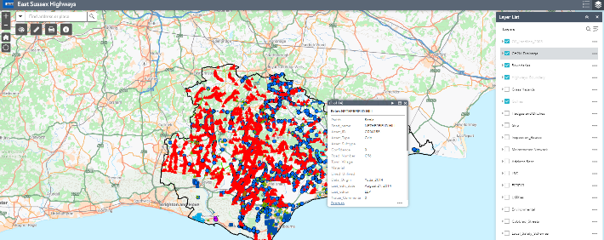
Our projects
Optimising customer experience and road maintenance in East Sussex
Digital integration
Solutions architecture
Challenge
East Sussex Highways wanted to provide a unique, entirely customer focused experience for the public with regards to road issues and to gain instant access to information on the condition of their assets.
Solution
We created a single source of truth for project information without compromising data privacy and safety restrictions. We then deployed a series of integrated, secure, cloud hosted, web and mobile GIS applications for over 400 users to streamline design workflows.
The solution integrated with social media and CRM platforms to inform customers about road works in their area and enabled web forms and online chat with customers.
Key benefits
Calls to Contact Centre reduced by 25% and response time increased
Road inspectors managing 150,000 assets now complete 60% more surveys per week
Control receives live asset updates rather than three days later and passes to maintenance teams more quickly
Simpler collaboration and improved productivity for office and field staff.

